Slide 1




Hibernate Introduction
Maven, Hibernate, Configuration, JPA, Annotations
Databases Frameworks
SoftUni Team
SoftUni Team
Technical Trainers
Technical Trainers
Software University
Software University
http://softuni.bg

Slide 2
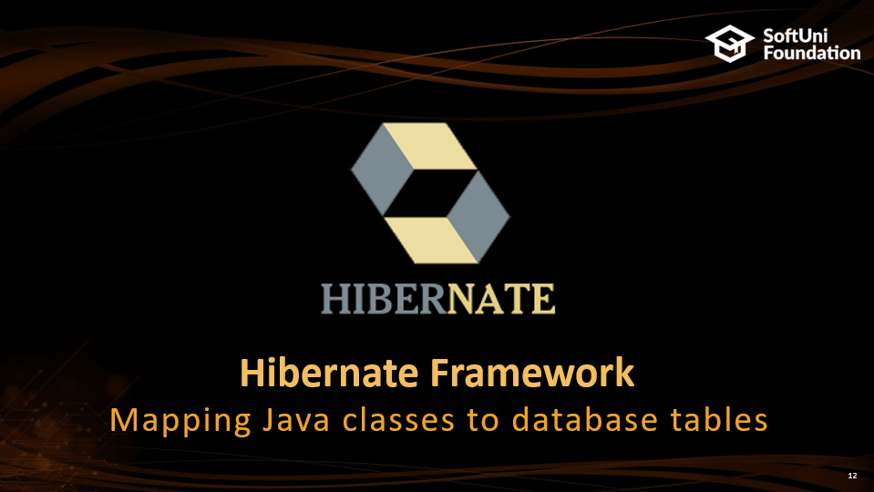
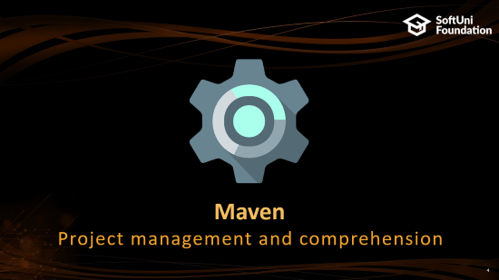
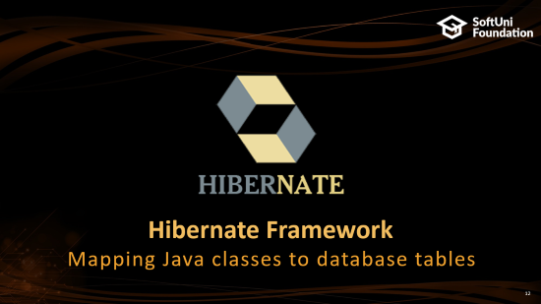
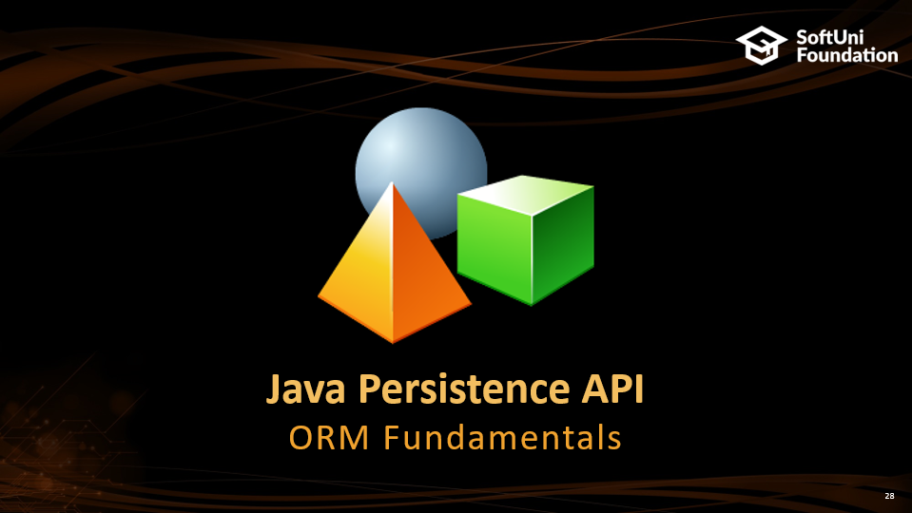
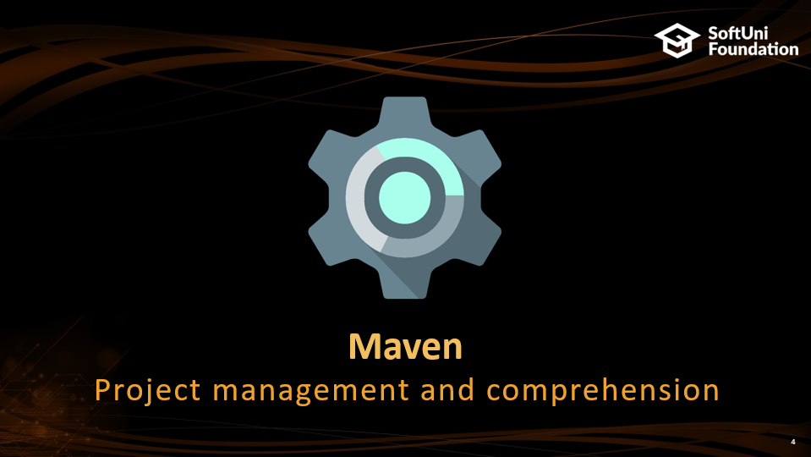
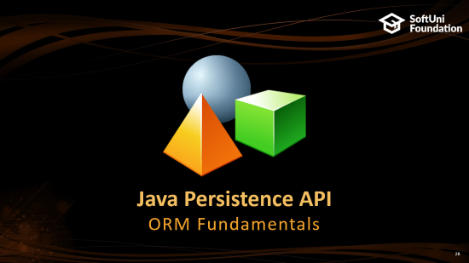
Table of Contents

Slide 3
Questions
sli.do #JavaDB

Slide 4

Maven
Project management and comprehension

Slide 5

Maven Overview
Maven is a built automation tool
Describes how software is built and it's dependencies
Uses XML files
Dynamically downloads Java libraries and Maven plug-ins
Projects are configured using a Project Object Model, which is stored in a pom.xml file

Slide 6
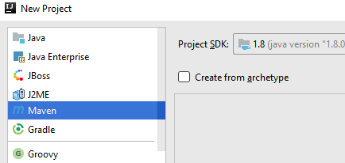
Setup – Creating a Maven project
Select "Maven" project from the new project panel

Slide 7
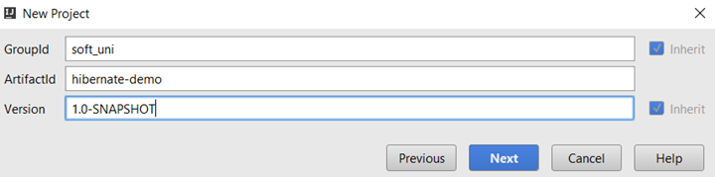
Setup (2)
Project group
Current project
Version

Slide 8
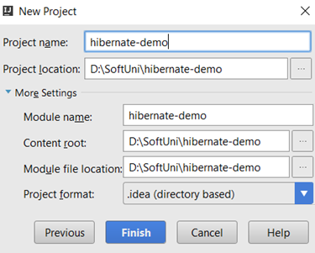

Setup (3)
Set up project name and location
Set up Maven auto-import

Slide 9

Maven Configurations
A Project Object Model(POM) is the fundamental unit of work in Maven
Configurations are held in the pom.xml file
When executing a task or goal, Maven looks for the POM file in the current directory

Slide 10
POM model
pom.xml
<build>
<plugins>
<plugin>
<groupId>org.apache.maven.plugins</groupId>
<artifactId>maven-compiler-plugin</artifactId>
<version>3.5.1</version>
<configuration>
<source>1.8</source>
<target>1.8</target>
</configuration>
</plugin>
</plugins>
</build>
Java compile version

Slide 11
Dependencies
Dependencies are set with the <dependency> tag
pom.xml
Dependency 1
<dependencies>
<dependency>
<groupId>org.hibernate</groupId>
<artifactId>hibernate-core</artifactId>
<version>5.2.3.Final</version>
</dependency>
<dependency>
<groupId>mysql</groupId>
<artifactId>mysql-connector-java</artifactId>
<version>6.0.4</version>
</dependency>
</dependencies>
Dependency 2

Slide 12

Hibernate Framework
Mapping Java classes to database tables

Slide 13

Hibernate Framework
Hibernate is a Java ORM framework
Mapping an object-oriented model to a relational database
It is implemented by the configuration of an XML file or by using Java Annotations
Maintain the database schema

Slide 14
Java ORM Approaches
Different approaches to Java ORM:
POJO (Plain Old Java Objects) + XML mappings
A bit old-fashioned, but very powerful
Implemented in the "classical" Hibernate
Annotated Java classes (POJO) mapped to DB tables
Based on Java annotations and XML
Easier to implement and maintain
Code generation - tools

Slide 15
Hibernate configuration
Add hibernate as a project dependency
pom.xml
<dependencies>
<dependency>
<groupId>org.hibernate</groupId>
<artifactId>hibernate-core</artifactId>
<version>5.2.3.Final</version>
</dependency>
<dependency>
<groupId>mysql</groupId>
<artifactId>mysql-connector-java</artifactId>
<version>5.1.6</version>
</dependency>
</dependencies>
Hibernate
MySQL connector
Notes:
<?xml version='1.0' encoding='utf-8'?> <!DOCTYPE hibernate-configuration PUBLIC "-//Hibernate/Hibernate Configuration DTD//EN" "http://www.hibernate.org/dtd/hibernate-configuration-3.0.dtd"> <hibernate-configuration> <session-factory> <property name="hibernate.dialect"> org.hibernate.dialect.MySQL5Dialect </property> <property name="hibernate.connection.driver_class"> com.mysql.jdbc.Driver </property> <!-- Connection Settings --> <property name="hibernate.connection.url"> jdbc:mysql://localhost:3306/school </property> <property name="hibernate.connection.username"> root </property> <property name="hibernate.connection.password"> 1234 </property> <property name="hbm2ddl.auto"> create </property> <!-- List of XML mapping files --> <mapping resource="Student.hbm.xml"/> </session-factory> </hibernate-configuration>

Slide 16
Hibernate configuration (2)
hibernate.cfg.xml
<?xml version='1.0' encoding='utf-8'?>
<!DOCTYPE hibernate-configuration
PUBLIC "-//Hibernate/Hibernate Configuration DTD//EN"
"http://www.hibernate.org/dtd/hibernate-configuration-3.0.dtd">
<hibernate-configuration>
<session-factory>
<property name="hibernate.dialect">
org.hibernate.dialect.MySQL5Dialect
</property>
<property name="hibernate.connection.driver_class">
com.mysql.jdbc.Driver
</property>
Configuration
SQL Dialect
Driver
Notes:
<?xml version='1.0' encoding='utf-8'?> <!DOCTYPE hibernate-configuration PUBLIC "-//Hibernate/Hibernate Configuration DTD//EN" "http://www.hibernate.org/dtd/hibernate-configuration-3.0.dtd"> <hibernate-configuration> <session-factory> <property name="hibernate.dialect"> org.hibernate.dialect.MySQL5Dialect </property> <property name="hibernate.connection.driver_class"> com.mysql.jdbc.Driver </property> <!-- Connection Settings --> <property name="hibernate.connection.url"> jdbc:mysql://localhost:3306/school </property> <property name="hibernate.connection.username"> root </property> <property name="hibernate.connection.password"> 1234 </property> <property name="hbm2ddl.auto"> create </property> <!-- List of XML mapping files --> <mapping resource="Student.hbm.xml"/> </session-factory> </hibernate-configuration>

Slide 17
Hibernate configuration (2)
hibernate.cfg.xml
<!-- Connection Settings -->
<property name="hibernate.connection.url">
jdbc:mysql://localhost:3306/school
</property>
<property name="hibernate.connection.username">
root
</property>
<property name="hibernate.connection.password">
1234
</property>
<property name="hbm2ddl.auto">
create
</property>
Connection string
User
Pass
Auto strategy

Slide 18
Hibernate configuration (3)
hibernate.cfg.xml
…
<!-- List of XML mapping files -->
<mapping resource="student.hbm.xml"/>
</session-factory>
</hibernate-configuration>
Mapping files

Slide 19
Hibernate Implementation Example
POJO (Plain Old Java Objects) + XML mappings
public class Student {
private int id;
private String name;
private Date registeredOn;
// Constructor, getters and setters
}

Slide 20
Hibernate mapping
student.hbm.xml
<?xml version="1.0" encoding="utf-8"?>
<!DOCTYPE hibernate-mapping PUBLIC
"-//Hibernate/Hibernate Mapping DTD//EN"
"http://www.hibernate.org/dtd/hibernate-mapping-3.0.dtd">
<hibernate-mapping>
<class name="entities.Student" table="students">
<id name="id" column="id">
<generator class="identity" />
</id>
…
Mapping file
Class mapping
Field mapping

Slide 21
Hibernate mapping (2)
student.hbm.xml
…
<property name="name" column="first_name" />
<property name="registrationDate" column="registration_date"/>
</class>
</hibernate-mapping>
Field mapping

Slide 22
Hibernate sessions
Main.java
public class Main {
public static void main(String[] args) {
Configuration cfg = new Configuration();
cfg.configure();
SessionFactory sessionFactory =
cfg.buildSessionFactory();
Session session = sessionFactory.openSession();
session.beginTransaction();
// Your Code Here
session.getTransaction().commit();
session.close();
}
}
Service Registry
Session
Transaction commit

Slide 23
Hibernate save data
Main.java
public static void main(String[] args) {
//…
session.beginTransaction();
Student example = new Student();
session.save(example);
session.getTransaction().commit();
session.close();
}
}
Save object

Slide 24
Hibernate retrieve data by Get
Main.java
public static void main(String[] args) {
…
session.beginTransaction();
Student student = (Student) session.get(Student.class, 1);
session.getTransaction().commit();
session.close();
}
}
Get object

Slide 25
Hibernate retrieve data by Query
Main.java
public static void main(String[] args) {
// …
session.beginTransaction();
List<Student> studentList =
session.createQuery("FROM Student ").list();
for (Student student : studentList) {
System.out.println(student.getId());
}
session.getTransaction().commit();
session.close();
}
}
Get list of objects

Slide 26
Hibernate Querying Language - HQL
SELECT
"FROM Student"
SELECT + WHERE
"FROM Student WHERE name = 'John'"
SELECT + JOIN
"FROM Student AS s
JOIN s.major AS major"

Slide 27
Hibernate retrieve data by Criteria
Main.java
public static void main(String[] args) {
//…
session.beginTransaction();
List<Student> studentList = session.createCriteria(Student.class)
.add(Restrictions.like("name", "P%")).list();
for (Student student : studentList) {
System.out.println(student.getId());
}
session.getTransaction().commit();
session.close();
}
Get list of objects by criteria

Slide 28

Java Persistence API
ORM Fundamentals

Slide 29
About JPA
What is Java Persistence API (JPA)?
Database persistence technology for Java (official standard)
Object-relational mapping (ORM) technology
Operates with POJO entities with annotations or XML mappings
Implemented by many ORM engines: Hibernate, EclipseLink, …

Slide 30

About JPA (2)
JPA maps Java classes to database tables
Maps relationships between tables as associations between classes
Provides CRUD functionality and queries
Create, read, update, delete + queries

Slide 31
Entities in JPA
A JPA entity is just a POJO class
Abstract or concrete top level Java class
Non-final fields/properties, no-arguments constructor
No required interfaces
Direct field or property-based access
Getter/setter can contain logic (e.g. validation)

Slide 32
Entity Class: Student
Student.java
@Entity @Table(name = "students")
public class Student {
@Id
@GeneratedValue(strategy = GenerationType.IDENTITY)
@Column(name = "id")
private int id;
@Column(name = "name", length = 50)
private String name;
@Column(name = “birth_date")
private Date birthDate;
// Getters and setters
}
Set table name
Primary key
Identity
Column name
Column name and length
Column name

Slide 33
Annotations
@Entity - Declares the class as an entity or a table
@Table - Declares table name
@Basic - Specifies non-constraint fields explicitly
@Transient - Specifies the property that is not persistent, i.e., the value is never stored in the database

Slide 34
Annotations (2)
@Id - Specifies the property, use for identity (primary key of a table) of the class
@GeneratedValue - specifies how the identity attribute can be initialized
Automatic, manual, or value taken from a sequence table
@Column -Specifies the column attribute for the persistence property

Slide 35
JPA Configuration
pom.xml
<project xmlns="http://maven.apache.org/POM/4.0.0" xmlns:xsi="http://www.w3.org/2001/XMLSchema-instance"
xsi:schemaLocation="http://maven.apache.org/POM/4.0.0 http://maven.apache.org/maven-v4_0_0.xsd">
<modelVersion>4.0.0</modelVersion>
<groupId>com.javawebtutor</groupId>
<artifactId>JPAMavenExample</artifactId>
<packaging>jar</packaging>
<version>1.0-SNAPSHOT</version>
<name>JPAMavenExample</name>
<url>http://maven.apache.org</url>
…

Slide 36
JPA Configuration (2)
pom.xml
…
<dependencies>
<dependency>
<groupId>org.eclipse.persistence</groupId>
<artifactId>javax.persistence</artifactId>
<version>2.1.0</version>
</dependency>
<dependency>
<groupId>org.hibernate</groupId>
<artifactId>hibernate-core</artifactId>
<version>5.2.3.Final</version>
</dependency>

Slide 37
JPA Configuration (3)
pom.xml
…
<groupId>mysql</groupId>
<artifactId>mysql-connector-java</artifactId>
<version>5.1.27</version>
</dependency>
</dependencies>
</project>

Slide 38
JPA Configuration
persistence.xml
<?xml version="1.0" encoding="UTF-8"?>
<persistence xmlns="http://java.sun.com/xml/ns/persistence" version="2.0">
<persistence-unit name="school">
<properties>
<property name = "hibernate.connection.url" value="jdbc:mysql://localhost:3306/school"/>
<property name = "hibernate.connection.driver_class" value="com.mysql.jdbc.Driver"/>
…

Slide 39
JPA Configuration (2)
persistence.xml
…
<property name = "hibernate.connection.username" value="root"/>
<property name = "hibernate.connection.password" value="1234"/>
<property name = "hibernate.dialect" value="org.hibernate.dialect.MySQL5Dialect"/>
<property name = "hibernate.hbm2ddl.auto" value="create"/>
<property name = "hibernate.show_sql" value = "true" />
</properties>
</persistence-unit>
</persistence>

Slide 40
JPA save objects
Main.java
public static void main(String[] args) {
EntityManagerFactory emf = Persistence.createEntityManagerFactory("school");
EntityManager em = emf.createEntityManager();
em.getTransaction().begin();
Student student = new Student("Teo", new Date());
em.persist(student);
em.getTransaction().commit();
}
}

Slide 41

JPA – Java Persistence API
Persistence
import javax.persistence.*;
==
JPA
createEntityManagerFactory()
Query
EntityManagerFactory
setParameter()
getResultList()
getSingleResult()
executeUpdate()
Entity
createEntityManager()
id
field1
field2
EntityManager
EntityTransaction
getTransaction()
find() / createQuery()
persist()
remove()
begin()
commit()
rollback()

Slide 42
Persistence Context (PC) and Entities
Persistence Context
Application
EntityManager
MyEntity a
MyEntity a
MyEntity b
MyEntity b
MyEntity c
Entity state
Database

Slide 43
Entity object life cycle
new
persist
retrieve
New /
Transient
Managed
merge
remove
detach
Detached
Removed
Database
clear, close
commit flush

Slide 44
JPA write data methods
persist() – persists given entity object into the DB (SQL INSERT)
remove() – deletes given entity into the DB (SQL DELETE by primary key)
refresh() – reloads given entity from the DB (SQL SELECT by primary key)

Slide 45
JPA write data methods (2)
detach() – removes the object from the persistence context(PC)
merge() – synchronize the state of detached entity with the PC
contains() - determine if given entity is managed by the PC
flush() – writes the changes from PC in the database

Slide 46
JPA read data methods
find() - execute a simple Select query by primary key
Main.java
public static void main(String[] args) {
EntityManagerFactory emf = Persistence.createEntityManagerFactory("school");
EntityManager em = emf.createEntityManager();
em.getTransaction().begin();
em.find(Student.class,1)
em.getTransaction().commit();
}
Get object

Slide 47
JPA delete objects
Main.java
public static void main(String[] args) {
EntityManagerFactory emf = Persistence.createEntityManagerFactory("school");
EntityManager em = emf.createEntityManager();
em.getTransaction().begin();
Student student = em.find(Student.class,1);
em.remove(student);
em.getTransaction().commit();
}
}
Remove object

Slide 48
JPA merge objects
Merges the state of detached entity into a managed copy of the detached entity
Returned entity has a different Java identity than the detached one
May invoke SQL SELECT
public Student storeUpdatedStudent(Student student) {
return entityManager.merge(student);
}

Slide 49

Summary
Maven helps us build our project easily
Easy dependency import by XMLs
Java Persistence API (JPA) is an official standard for Java ORMs
Hibernate is a widely used Java ORM
Implements JPA

Slide 50







Database Frameworks – Intro to Hibernate
https://softuni.bg/courses/databases-advanced-hibernate

Slide 51

License
This course (slides, examples, demos, videos, homework, etc.) is licensed under the "Creative Commons Attribution-NonCommercial-ShareAlike 4.0 International" license
Attribution: this work may contain portions from
"Databases" course by Telerik Academy under CC-BY-NC-SA license

Slide 52




Free Trainings @ Software University
Software University Foundation – softuni.org
Software University – High-Quality Education, Profession and Job for Software Developers
softuni.bg
Software University @ Facebook
facebook.com/SoftwareUniversity
Software University Forums
forum.softuni.bg

